Slide 1
RECOVERING CENTRES
The path to a successful surgery
Presented by GHAZI MEJBRI, CEO of SMEDI GROUP

Slide 2
Recovering Centers
Post-operative
monitoring
Rehabilitation
Reeducation
Recovering and
Rehabilitation center

Slide 3
Recovering Centers
The Recovery and Rehabilitation centre aims to ?
1- Ensure the safety and comfort of the patient on return from the hospital
2- Enable the patient to regain as much autonomy as possible as fast as possible
3- Prevent possible complications related to the operation.
4- Enable the patient to manage his or her possible disability

Slide 4
Recovering Centers
Reeducation Rehabilitation
Restore autonomy
as much as possible
as fast as possible
To optimize functioning and
REDUCE disability

Slide 5
The SMEDI Group
Our approach to rehabilitation and re-education

Slide 6
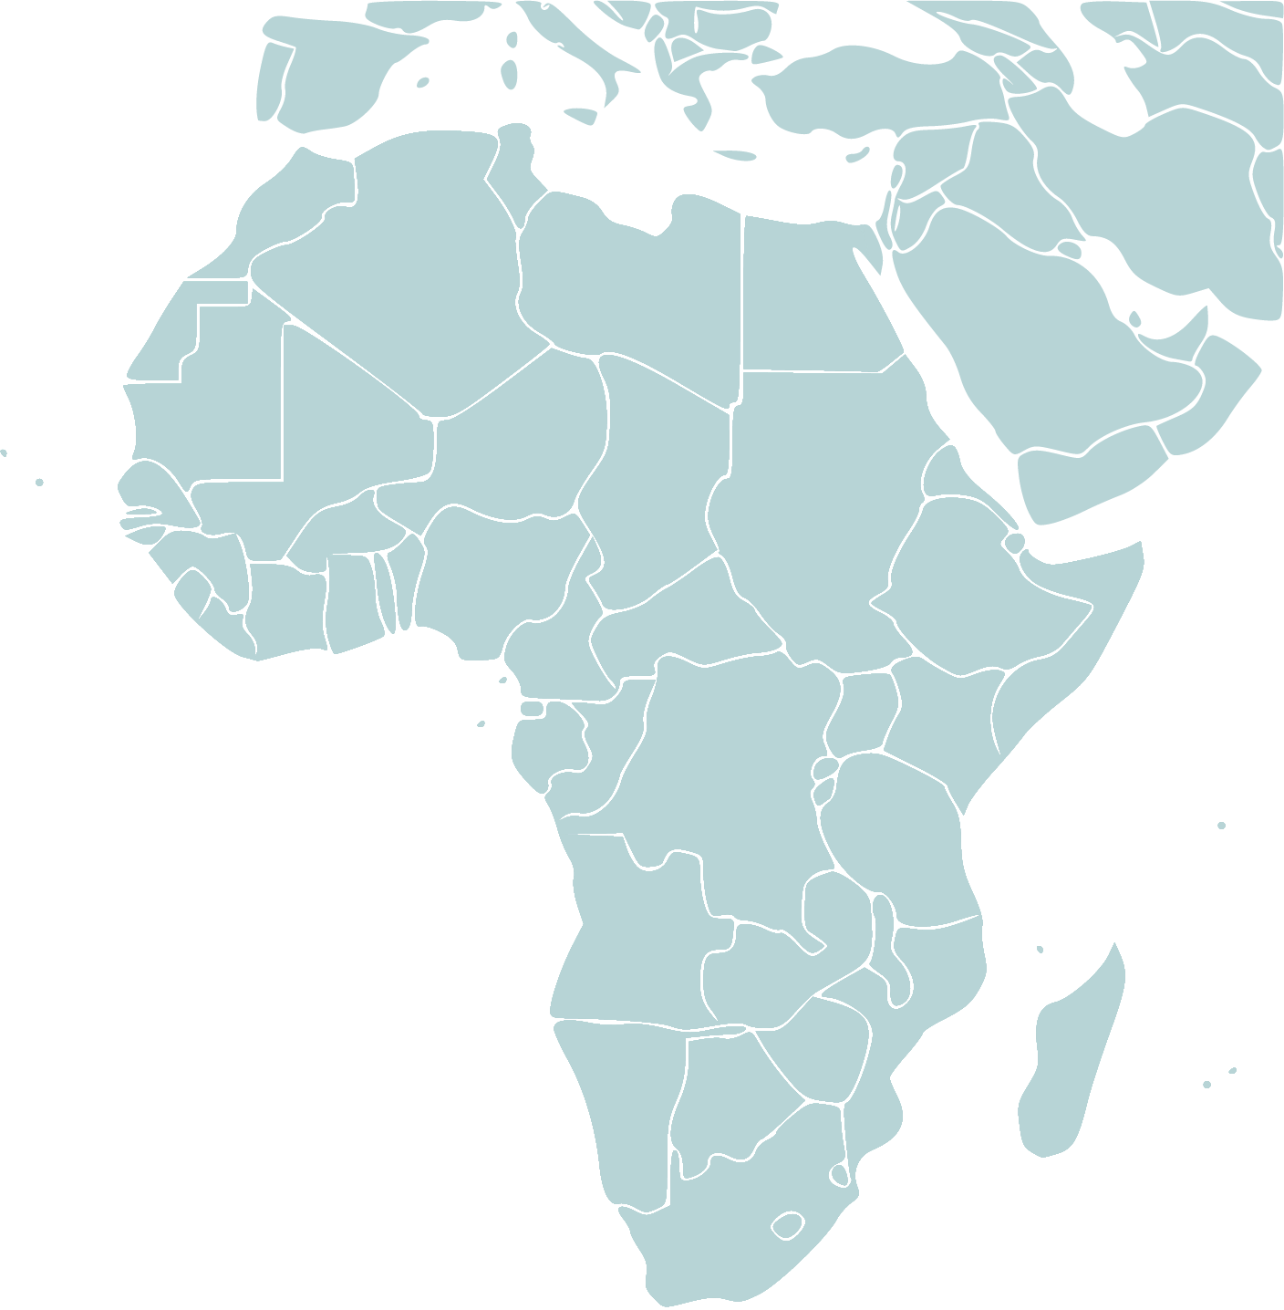
Who are we? The SMEDI Group :
SMEDI Group international is originally a medical services company with private capital, created in 2007 in Tunisia and present in a through subsidiaries and representatives Dozen countries in Africa

Slide 7
The SMEDI Group
SMEDI Group is currently composed of four subsidiaries corresponding to four main activities:
Care
Invest
Engineering
Nursing

Slide 8
SMEDI CARE :
A subsidiary, specialising in medical evacuation and facilitation, with offices in 13 countries (Gabon, Guinée, Côte d’Ivoire, Benin, Burkina Faso, Tunisie, Mali, Niger, Togo, RD Congo, Tchad).

Slide 9
SMEDI INVEST :
A SMEDI company that builds and manages hospitals and health facilities. It has private hospitals and new projects in many African cities such as Tunis, Libreville, Port Gentil, Conakry and Kamsar.

Slide 10
SMEDI ENGINEERING :
a SMEDI Company for consulting, studies and capacity building

Slide 11
SMEDI NURSING :
Is a SMEDI company
Building and managing medical recovering centres (housing centres for dependent elderly people, convalescence centres, physiotherapy centres, after surgery centres).

Slide 12
Among SMEDI NURSING achievements and projects,
five different centres in Tunis, Tunisia.
With the most recent one, LE HAVRE CENTRE

Slide 13
LE HAVRE CENTRE
Le Havre is a place of life and personalised care, offering residents a new way of recovering, that meets their needs for convalescence reeducation and rehabilitation.

Slide 14
LE HAVRE CENTRE

Slide 15
LE HAVRE CENTRE
Residential care centre
Who welcomes :
➢ Guests/Patients with reduced mobility
➢ Guests/Patients in need of observation and medical care
➢ Guests/Patients in convalescence, pre- or post-operative
➢ Guests/Patients in a situation of dependence for one-off or long-term stays

Slide 16
LE HAVRE CENTRE
Medical rehabilitation
and recovery centre
Who welcomes :
➢ Guests/Patients in rehabilitation
➢ Guests/Patientsin recovery process
➢ Guests/Patients in the process of getting back into shape
➢ Guests/Patientslooking for care and well-being sessions

Slide 17
LE HAVRE CENTRE: A Holistic approach
We care as much about the physical health and medical care as we do about the mental health and mood of the patients
Beauty care
Organised
trip
Healthcare
Celebrations

Slide 18
LE HAVRE CENTRE
In order to offer its residents all the conditions of comfort and conviviality, Le Havre offers an entertainment programme capable of surprising its guests with activities that emphasise sharing, exchange and good spirits.

Slide 19
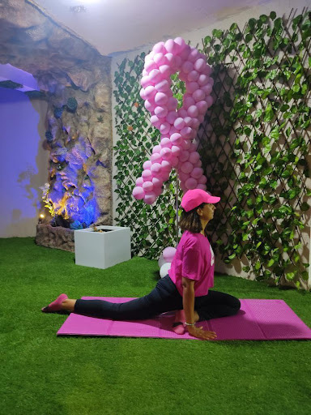
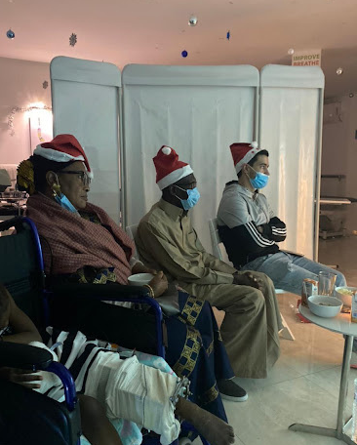
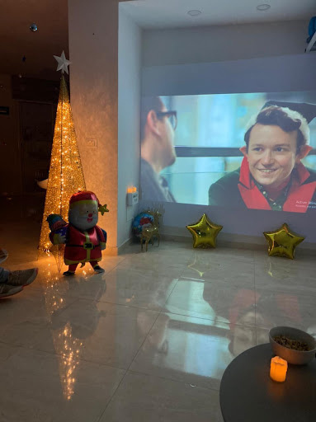
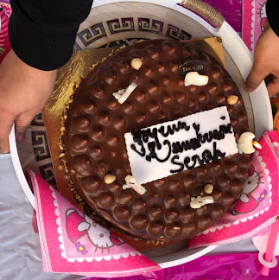
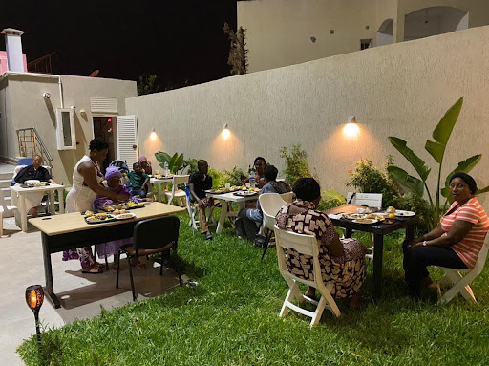
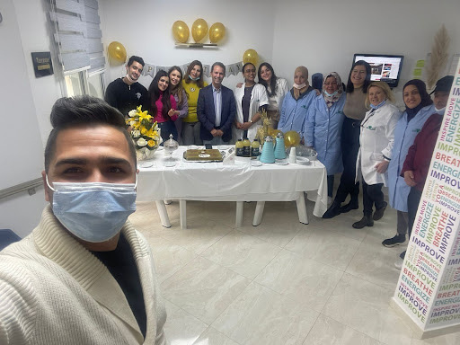
CELEBRATIONS
FILMS
PROJECTIONS
MUSIC AND
DANCE
ART AND
CREATIVITY
BBQ
PARTYS
YOGA/
PILATE
GAMES

Slide 20
LE HAVRE CENTRE
Our recovering centers are certified :
ISO 9001
QMS
ISO 14001 Environment
ISO 22000
Food Safety Management
Label Quality
FRANCE
Label
COVID

Slide 21
LE HAVRE CENTRE
Sustainability culture
- Our recovering centers are powered by solar pans
- We are using mostly local matierls
- We have a responsible management of waste
- Raising awareness about sustainability among our team and guests

Slide 22
Thank you for your attention !!
Don’t forget to vist our web site
www.smedi.com.tn
and Facebook page : Smedi santé

